Slide 1

Babich Kirill
Berukhov Andrey
Klochkov Lev
Repina Anastasia

Slide 2
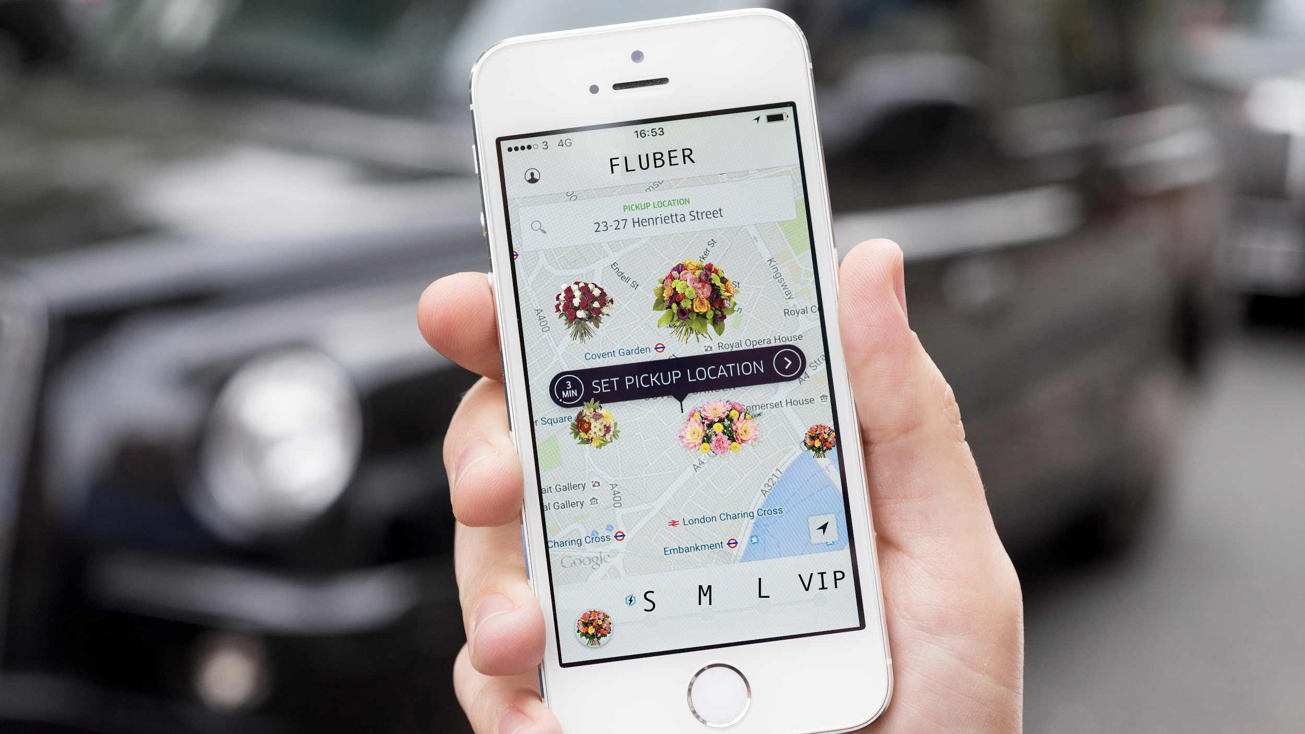
Idea

Slide 3

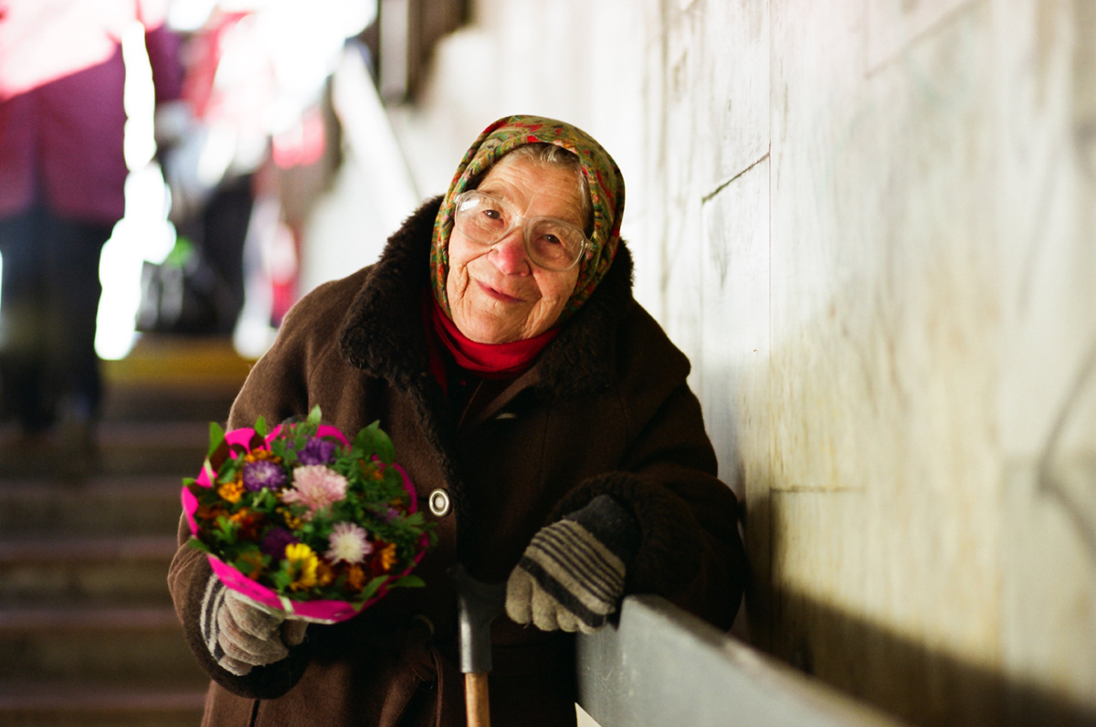
Main users
Buy & Sell Flowers

Slide 4
Functions
Flowers sale (for seller)
Flowers purchase (for buyer)
Filtration the results (to find the best variant)
Geotracking the sellers around and showing on map
Tracking the orders using notifications
Chat for buyer and seller

Slide 5
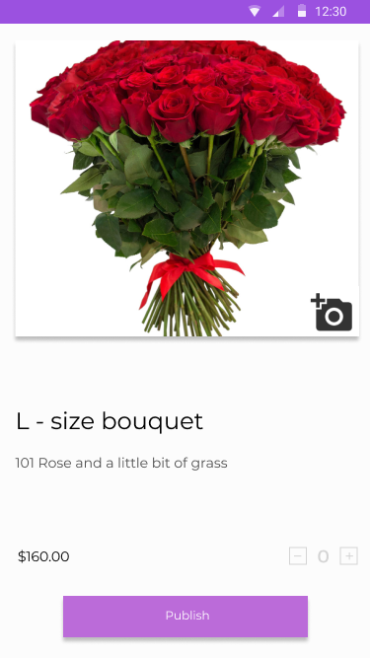
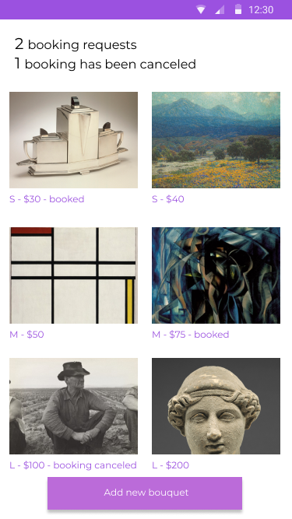
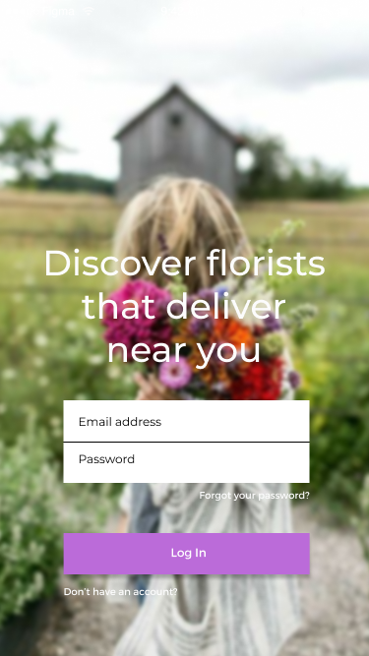
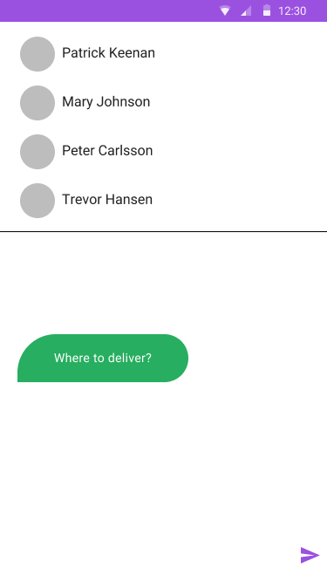
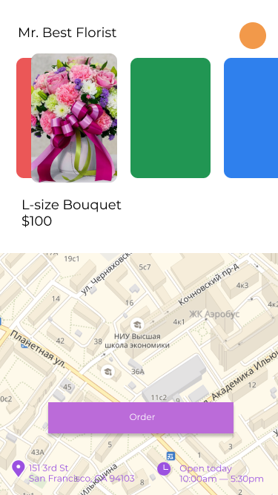
Mockups

Slide 6




Technologies

Slide 7
Thank you!
Contacts:
Babich Kirill - ksbabich@edu.hse.ru
Berukhov Andrey - asberukhov@edu.hse.ru
Klochkov Lev - lvklochkov@edu.hse.ru
Repina Anastasia - aarepina@edu.hse.ru

